Slide 1

Final Group Presentation
Trusha Sonawane
Yash Singh
Satnam Kaur Jaggi
Shivam Patel

Slide 2

Year Financial Analysis
This presentation examines the financial performance of years 2022, 2023 and 2024. We will analyze Total cost & spending patterns, Category wise Funding. The goal is to provide insights for Budget allocation & efficiency.
2

Slide 3

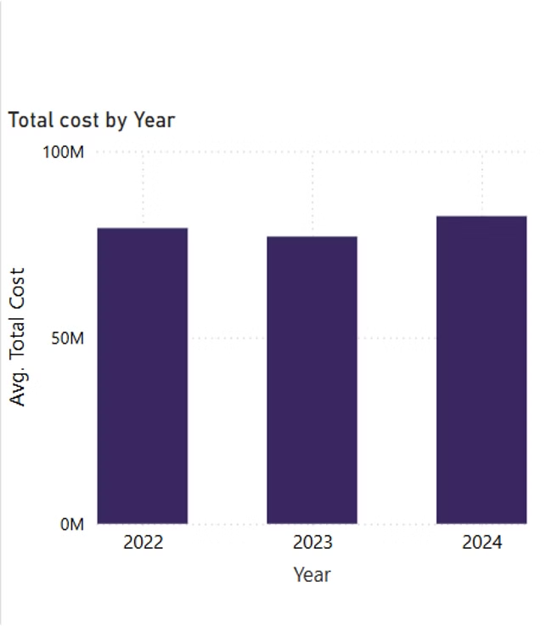
Total Cost by Year
The total cost has remained consistent across 2022, 2023, and 2024.
This suggests stable financial planning and spending over the years.
3

Slide 4

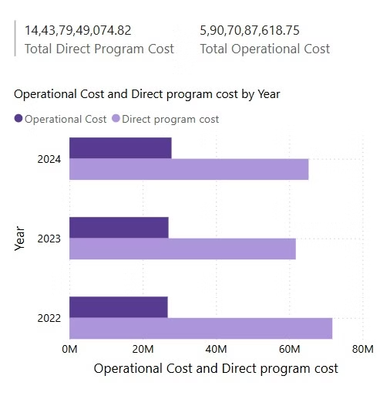
Operational cost and Direct program by Year
The majority of expenses are on direct program costs rather than operational costs.
Direct program costs have remained higher than operational costs, indicating a focus on program delivery rather than administrative expenses.
The allocation appears balanced across the three years.
4

Slide 5

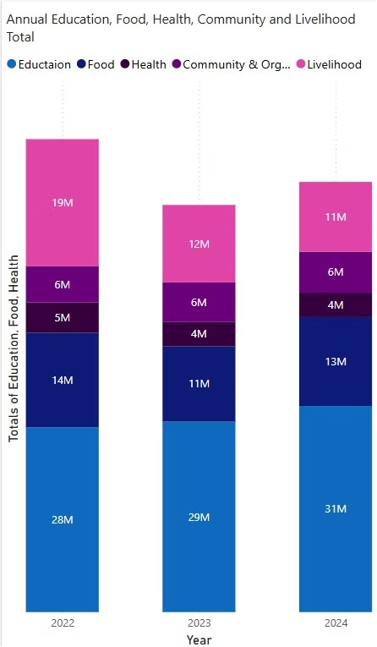
Annual Education,Food,Health, Community and Livelihood
Education consistently receives the highest funding across all three years.
Livelihood spending decreased from 19M in 2022 to 11M in 2024, indicating a shift in priorities.
Other categories (Health, Food, Community & Organization) have remained stable.
5

Slide 6

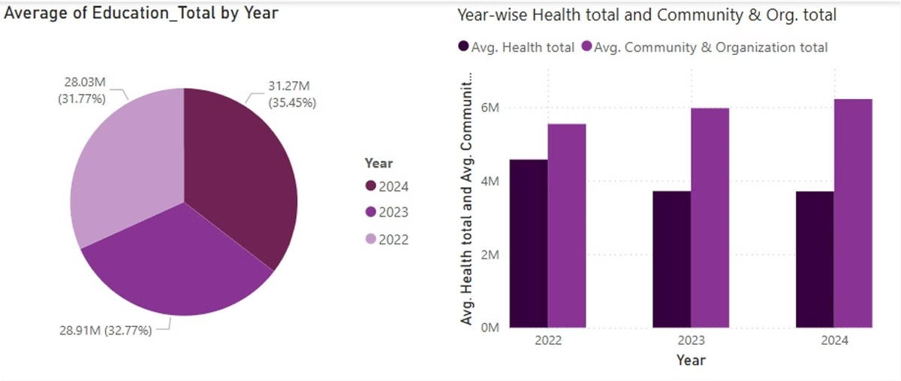
Average of Education, Health, Community & Org. Total by Year
Education spending has increased slightly over the years, reaching its peak in 2024 (31.27M, 35.45%).
The distribution remains fairly balanced across all three years.
Community & Organization spending has consistently been higher than Health in all years.
Both categories show a gradual increase from 2022 to 2024.
6

Slide 7

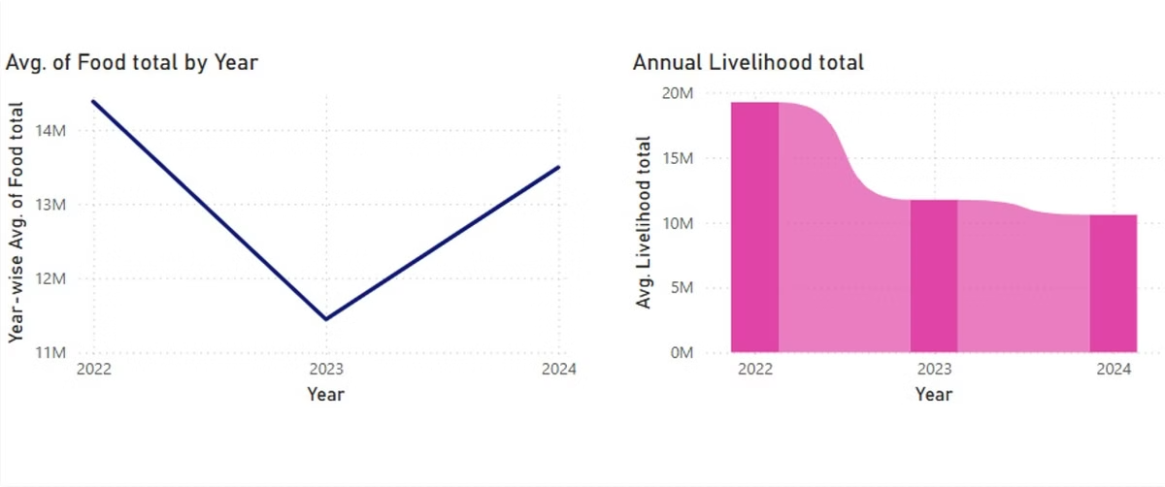
Average of Food and Livelihood by Year
Livelihood spending dropped significantly after 2022 and stabilized at a lower level in 2023 and 2024.
This suggests a strategic shift away from livelihood programs.
Food spending dropped in 2023 but recovered in 2024.
This indicates a possible budget reallocation or shifting priorities.
7

Slide 8

Partner Financial Analysis
This presentation examines the financial performance of partners A, B, and C. We will analyze cost distribution, budget vs. actual spending, and quarterly trends. The goal is to provide insights for better investment decisions.
8

Slide 9

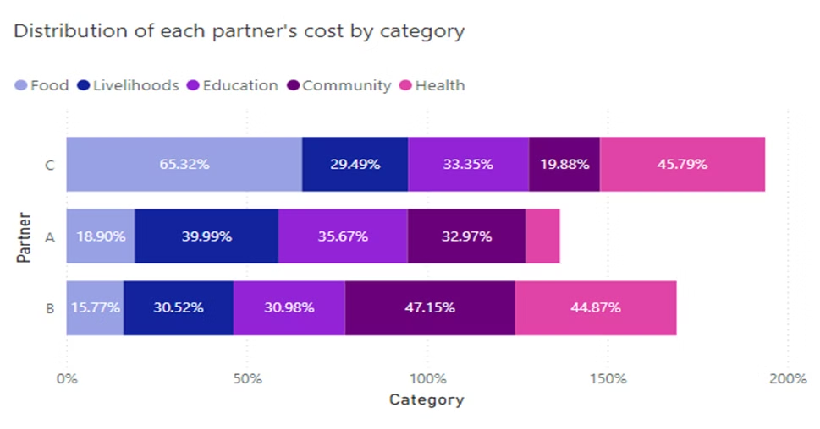
Cost Distribution by Category
Partner A
Partner B
Partner C
Livelihoods receive the largest share (39.99%). Education is second (35.67%). Food receives the lowest (18.90%).
Community expenses are highest (47.15%), followed by Health (44.87%). Food expenditure is 30.52%.
Food receives the largest share (65.32%) among other partners. Health accounts for 45.79%. Community receives 19.88%.
9

Slide 10

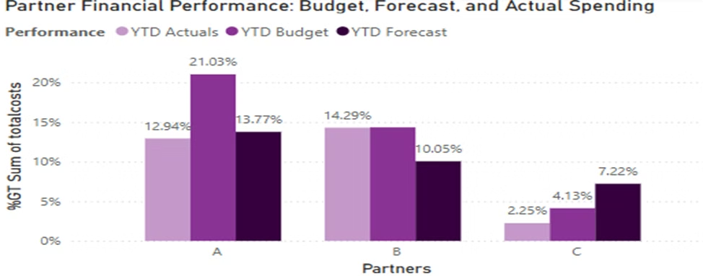
Budget vs. Actual Spending
Partner A
Actual spending uses few funds compared to budgeted amount. Forecast reveals slight variation from actual.
Partner B
Actual spending (14.29%) matches the budget. Forecast suggests a decrease to 10.05%. Overall indicates success through its financial metrics
Partner C
Actual spending (2.25%) is well below budget (4.13%) and forecast (7.22%) thus indicating unidentified future payments.
10

Slide 11

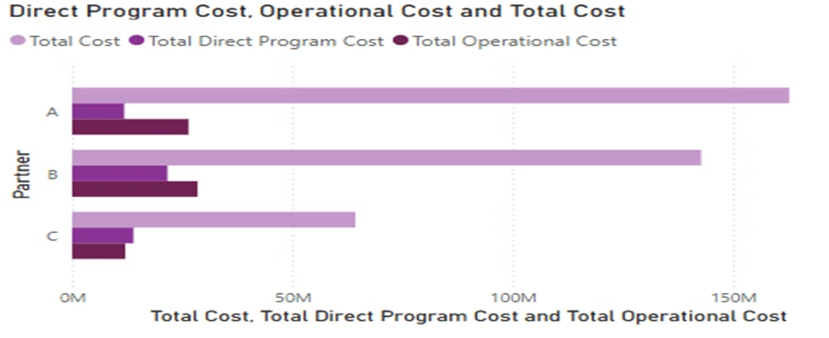
Cost Breakdown
Partner A
Highest total cost, exceeding $150M. Focus on program execution.
Partner B
Second-highest total cost, slightly below A. Efficient program spending.
Partner C
Lowest total cost, under $100M. Smaller scale operation.
11

Slide 12

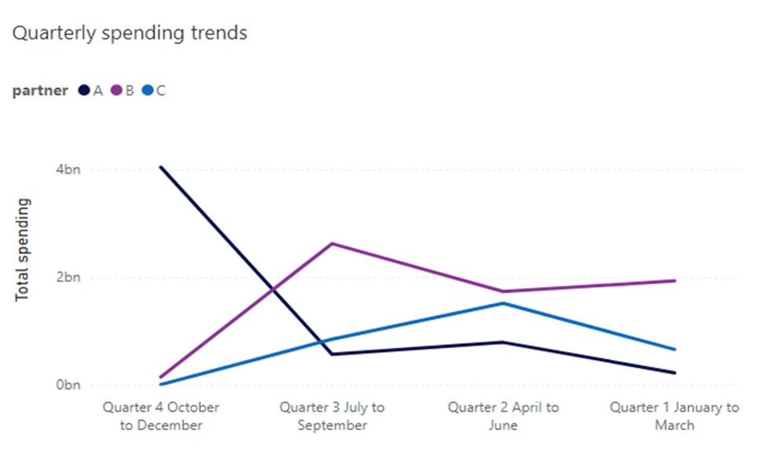
Quarterly Spending Trends
Partner A
Peak spending in Q4, then decreased dramatically.
Spending remained constant from Q2 to Q1, indicating a declining trend overall.
Partner B
Spending climbed significantly in Q3, then decreased from Q2 onwards.
Partner C
Consistent growth until Q2, then a slight fall.
12

Slide 13

Key Takeaways
Spending Patterns
Partners exhibit different budget allocation and spending strategies.
Efficiency
Direct program expenditures are prioritized over operational costs.
Recommendations
Partners should evaluate spending and adjust financial predictions.
13

Slide 14

Thank You

